Slide 1



PAHICHAN
Work - Achieve - Share

Slide 2




Meet Our Team
Arjun Adhikari
Samir Poudel
Sunil Gautam
Er. Nishal Gurung
Project Leader
Member
Member
Supervisor

Slide 3
INTRODUCTION
Pahichaan⁺ is a web application which enables
the users to post their recognition status.
In addition, Users can connect to
each other and react to the posts offered
by their connections. Also, Conversation feature
is available.

Slide 4
CURRENT SCENARIO
The traditional method of sharing self
recognition status was a bit tedious and couldn’t
get broad recognition in a short period of time.
We had to share such information in-person and broad advertisement was not possible.
Not all Social site are purely based on the
Recognition status that we are focused on.

Slide 5
OBJECTIVES
Posting various achievements related pictures and status.
To notify user on events .
Message connections .
Create connections with people you know and admire.
IP tracking and blocking mechanism.

Slide 6
FEATURES
Sharing medias related to Recognition status
Connections to other users.
Direct Conversation to the Connections.

Slide 7
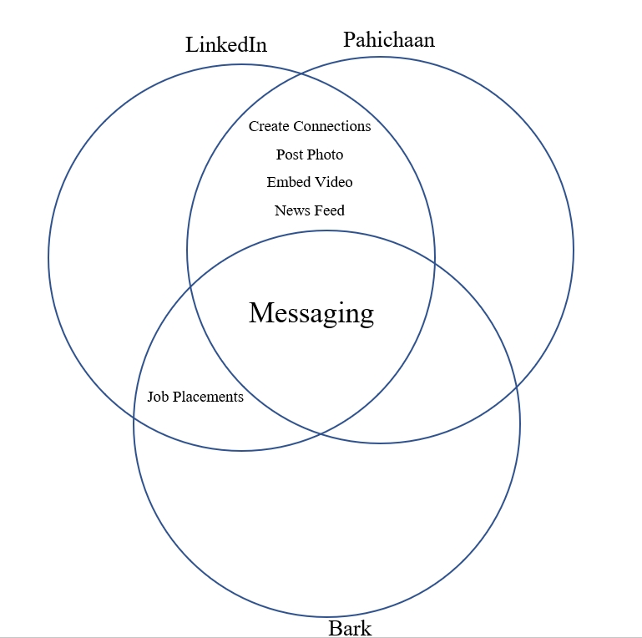
LITERATURE REVIEW
LinkedIn
Pahichaan⁺
Create Connection
Post Photo
Embed Video
Newsfeed
Messaging
Job Placement
Create Connection
Post Photo
Embed Video
Newsfeed
Messaging
Job Placement
Bark
Create Connection
Post Photo
Embed Video
Newsfeed
Messaging
Job Placement
Feature Available
Feature Unavailable

Slide 8
USE CASE

Slide 9
SSD

Slide 10
contd

Slide 12



WIREFRAME

Slide 13
Any Queries?

